Slide 1

Valuation of
——with DCF and Relative Valuation
January 8, 2025
Group Members: Weilong Wu, Yunfei Zhang, Tianqi Wu, Jiacheng Huang, Siyu Hu

Slide 2
Key Takeaways
Company Profile: Zhihu, referred to as "China's Quora," is a leading knowledge-sharing platform in China that has captivated a large and engaged user base. It offers a diverse range of topics and expert insights, focusing on user-generated content and community-building.
IPO Review: Zhihu officially listed on the Hong Kong Stock Exchange on April 22, 2022. It became the first Chinese internet company to adopt a dual primary listing in Hong Kong. The initial public offering (IPO) price was set at 32.06 Hong Kong dollars per share. This listing did not involve the issuance of new shares, as the shares offered were from early investors, totaling 26 million shares.
Valuation: After analyzing the market structure and business operations, and through DCF fundamental valuation and relative valuation, we believe that the actual value of Zhihu is 16.78 yuan per share. Therefore, the issuance price is too high, and it is not worthwhile for investors to participate in this IPO. We believe that Zhihu faces intense market competition, and the company's future revenue and cash flow cannot support such a high issuance price.

Slide 3
CONTENT
1
Company Profile
2
IPO review
3
Fundamental Valuation & Relative Valuation
4
Additional discussion

Slide 4
PART I: Company Profile
Company Profile

Slide 5
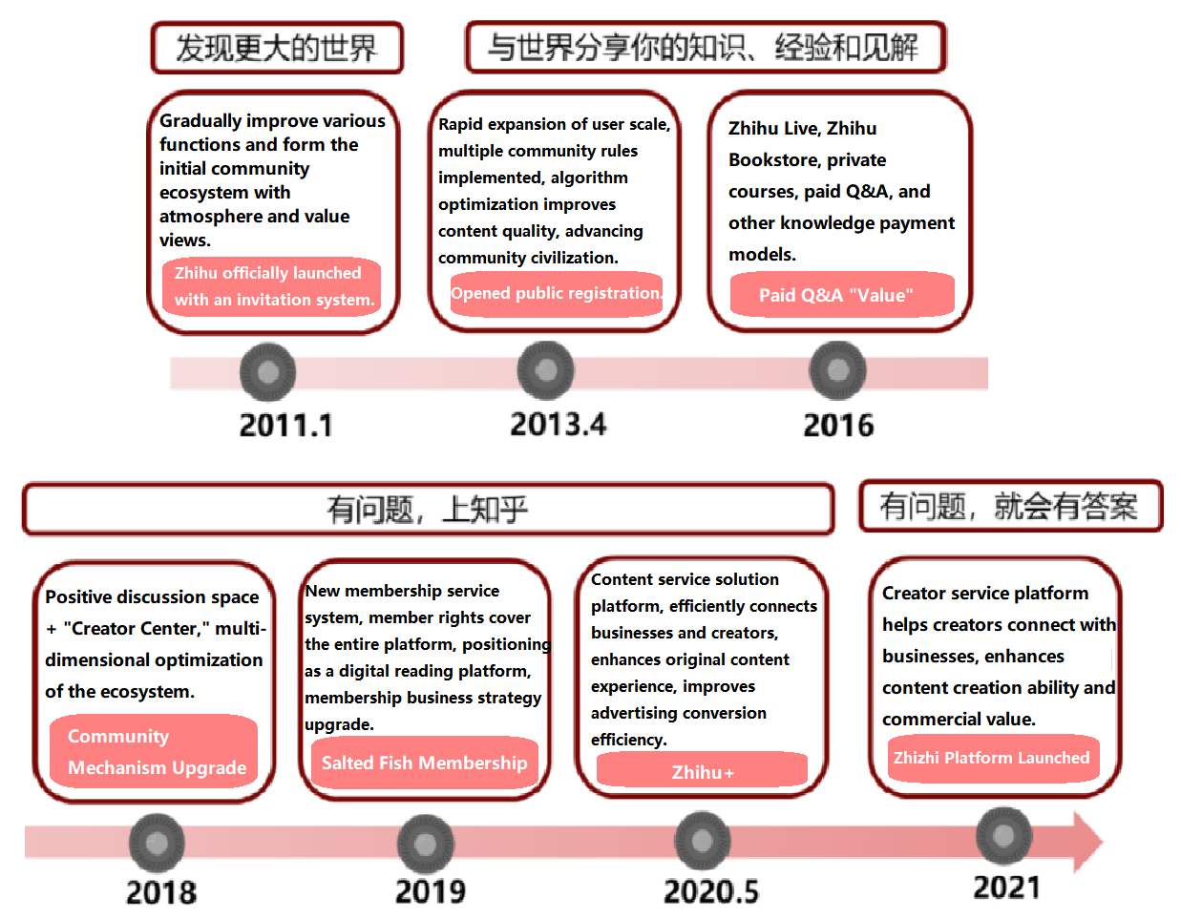
PART I: Company Profile
Zhihu: An Evolving Knowledge Community
Zhihu is a knowledge community centered on Q&A, based on user-generated content. It is one of the top 5 comprehensive online content communities in China, mainly in the form of Q&A and user-generated content. As a platform for knowledge sharing and content creation, Zhihu has a diverse user base and content ecosystem. Zhihu aims to enable everyone to share knowledge, gain insights, and reach a wider audience, while continuously optimizing the user experience, integrating platform advantages, and expanding advertising, membership, business solutions, and other online commercialization services.
The company's development process can be divided into the following stages:
1) Building a Large Ecosystem and Defining Content Positioning
2) User-Driven Growth
3) Exploring Content Value and Commercialization

Slide 6
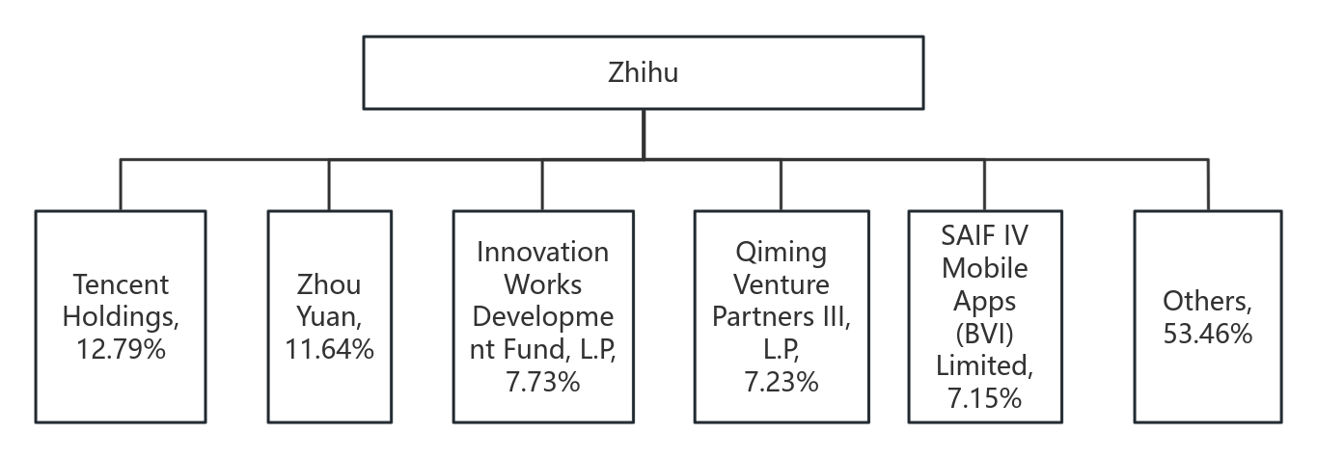
PART I: Company Profile
Structure and Core Executives
Equity Structure: Zhihu's equity structure is relatively dispersed, with its founder Zhou Yuan as the controlling shareholder who held 11.64% of the shares and 42.86% of the voting rights. Other major shareholders included Tencent (12.02%), Innovation Works (7.28%), Qiming Venture Partners (7.24%), SAIF Partners (5.69%), and Kuaishou (6.31%).
Core Executives: Zhou Yuan serves as the founder, chairman, and CEO, who is responsible for the overall strategic planning, product design, business development, and management of the company. Li Dahai is the Chief Technology Officer. Sun Wei is the Chief Financial Officer.

Slide 7
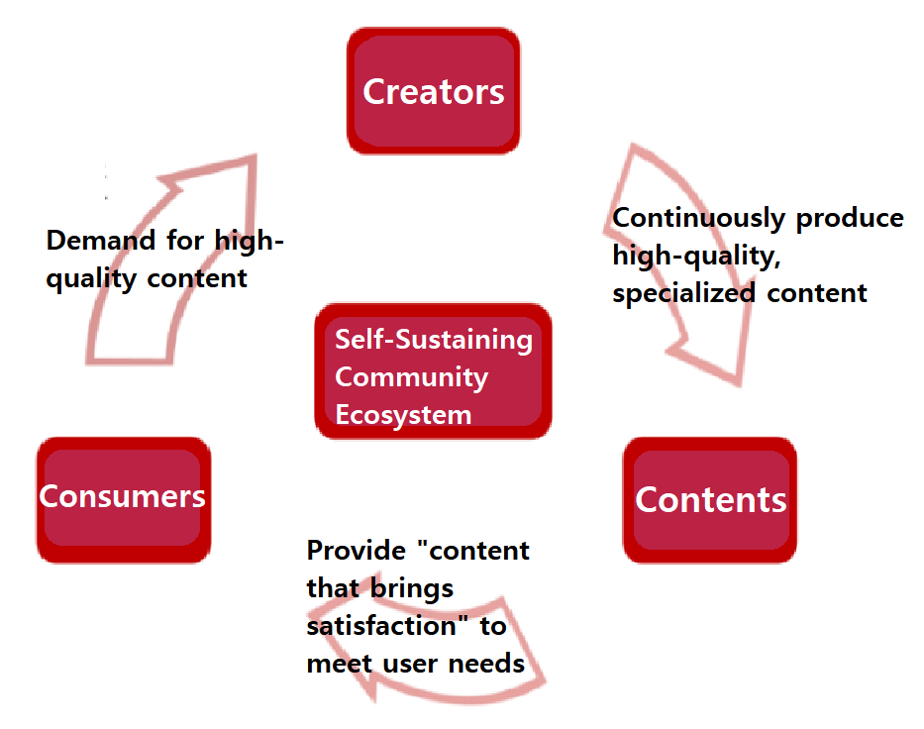
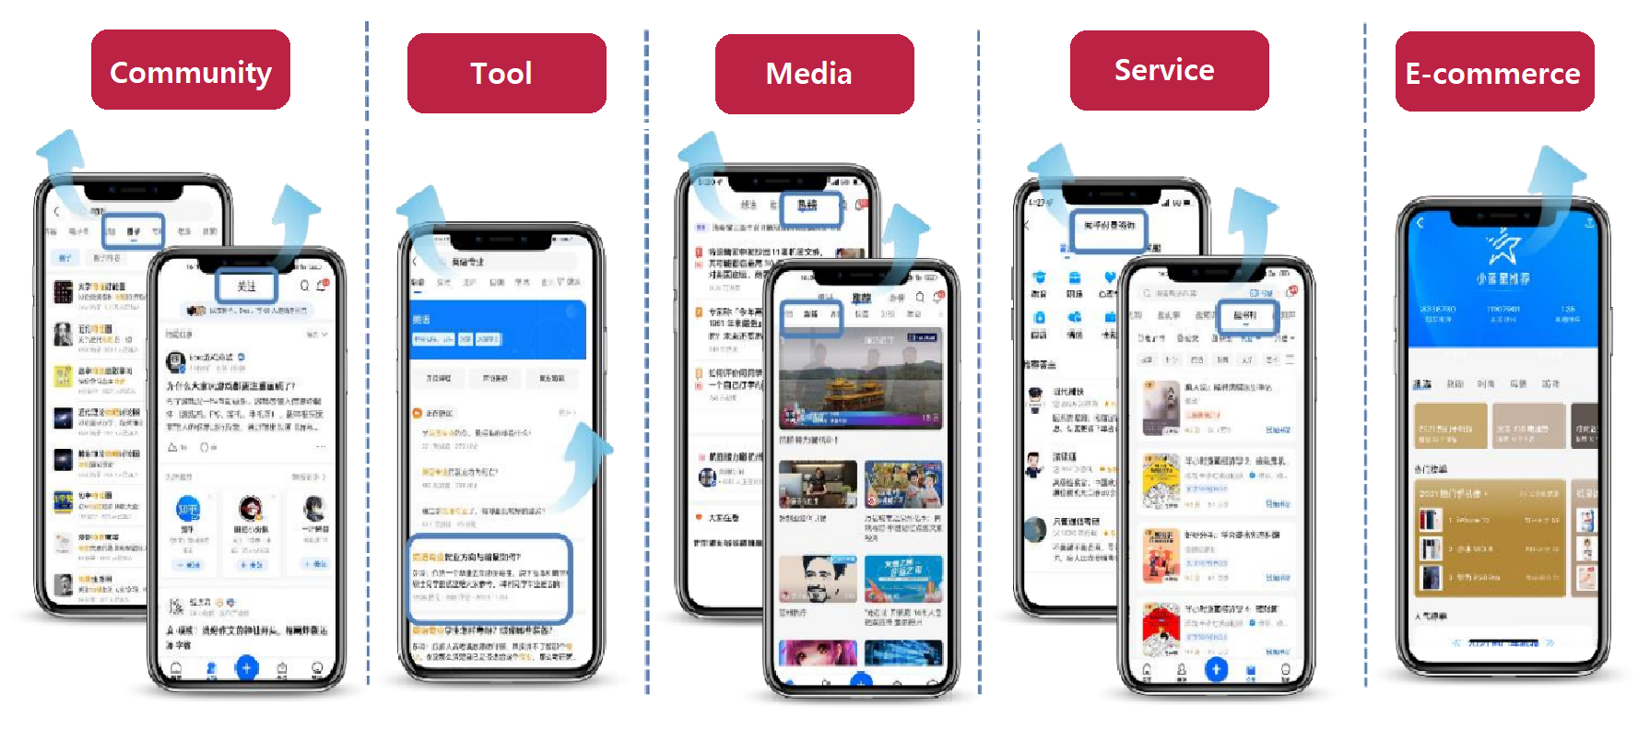
PART I: Company Profile
Core Business: Building a Community with Q&A
Zhihu has grown into a comprehensive community with attributes of a social network, tool, and media platform. Initially as a Q&A community, Zhihu has continuously evolved and now integrates features of Q&A, media, services, and e-commerce. Users can ask questions in the community and invite others to answer, or directly consume content as viewers. Additionally, users can conduct transactions on the platform, such as purchasing products, consulting services, and buying paid courses.
Creators, Content, and Consumers Achieve an Ecological Cycle, Jointly Building Zhihu's Content Creation Loop. Zhihu's content ecosystem is mainly composed of creators, content, and consumers. Creators select questions on the platform to answer and upload, or they create and upload videos, live streams, and other content. Consumers choose content that interests them to view, like, comment, and follow.

Slide 8
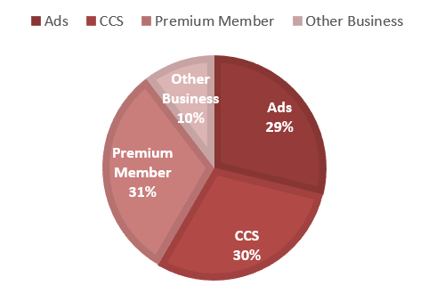
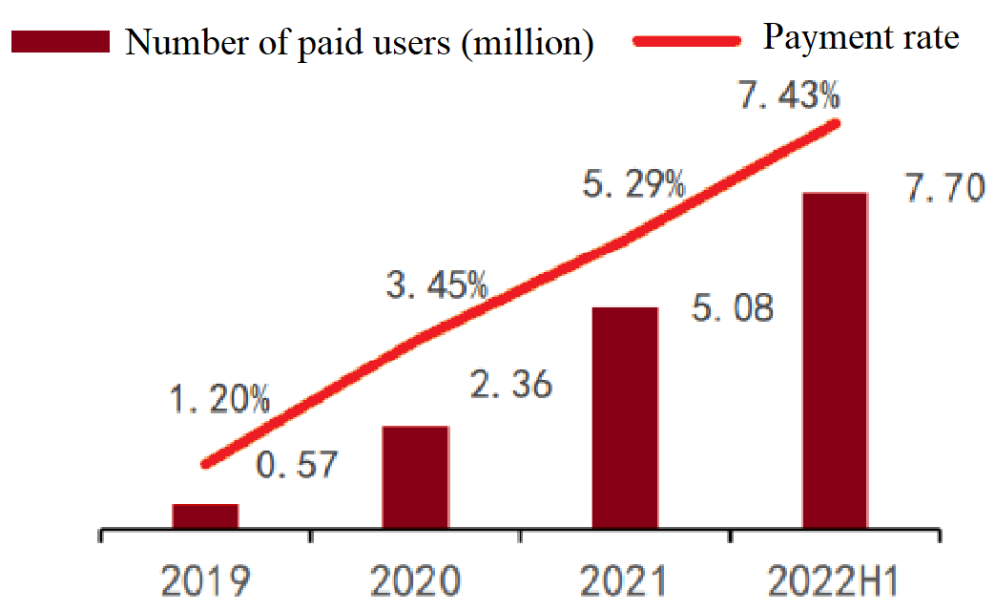
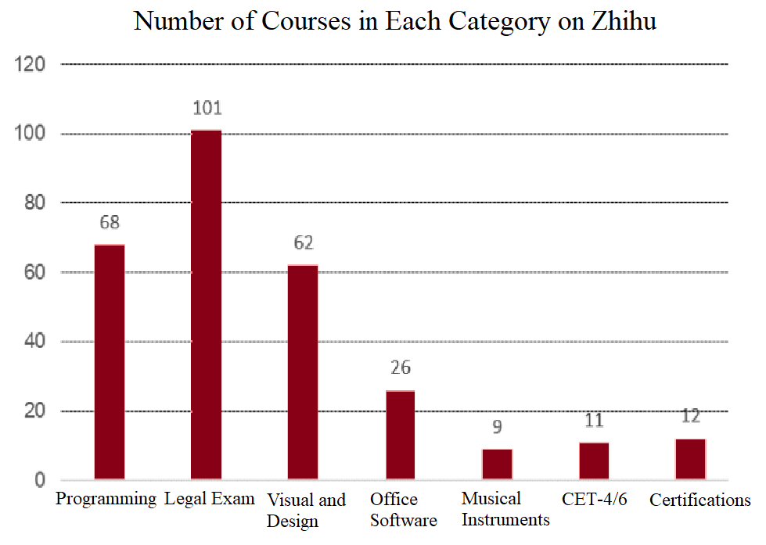
PART I: Company Profile
Content Commercialization
Zhihu's commercialization has blossomed in multiple areas, accelerating its release since 2020.
As Zhihu's user base continues to grow, the platform becomes increasingly attractive to brand owners, allowing its advertising business to make continuous progress with the product ‘Zhi+’.
Zhihu's content paid service aligns well with the platform's professional Q&A tone.
Membership benefits are diverse, and the paid content library includes 3.9 million pieces of content. The membership business is expected to continue growing, driven by an increase in the payment rate as the user base expands.
Zhihu is actively expanding its vocational education business.
In 2018, the company partnered with the Chinese MOOC platform "XuetangX." In 2021, Zhihu acquired Pinzhi Education and Papa Education, two educational training companies specializing in financial professional certificate exams and study abroad exam training, respectively.

Slide 9
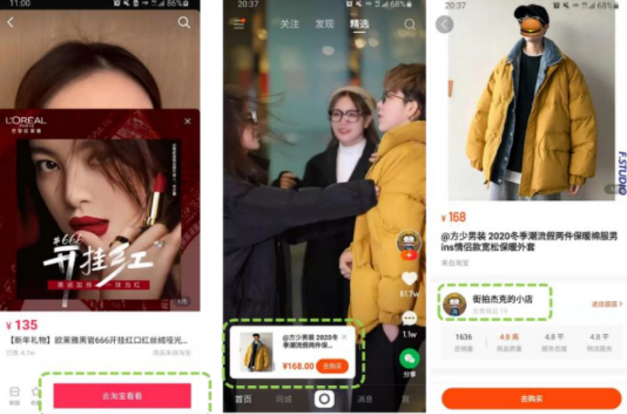


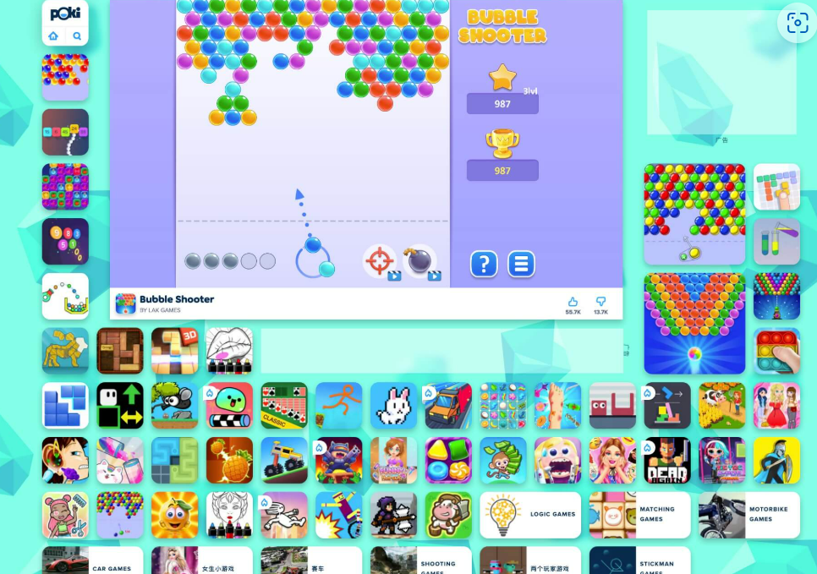
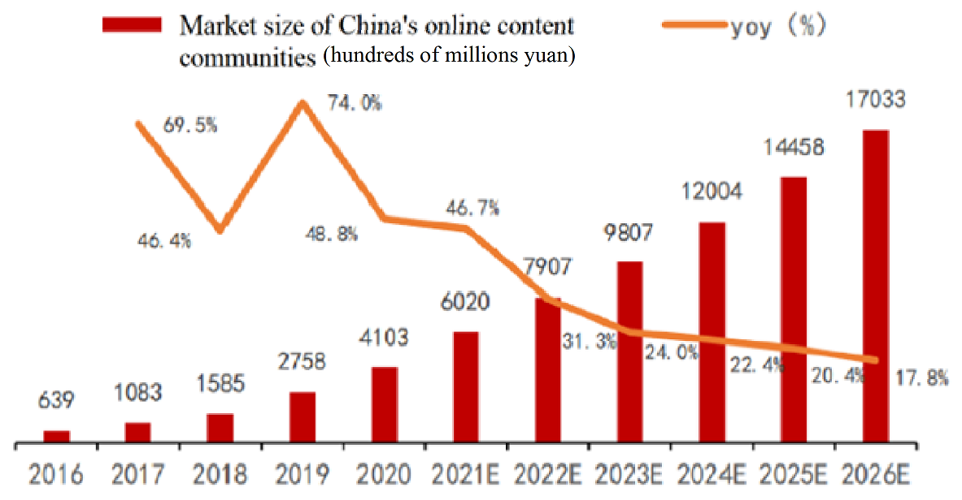
PART I: Company Profile
Market Potential: Acceleration of Internet Commercialization
The online community market continues to grow rapidly, with vast potential for future growth. Since the advent of the mobile internet era in 2012, user dividends have continuously driven overall growth in the internet industry, leading to a fast-growing internet community market.
The growth logic of the industry is shifting from user growth to the release of commercial value.
Internet community commercialization is flourishing in multiple areas, with stable growth in advertising and memberships, while e-commerce and training are poised for development.

Slide 10
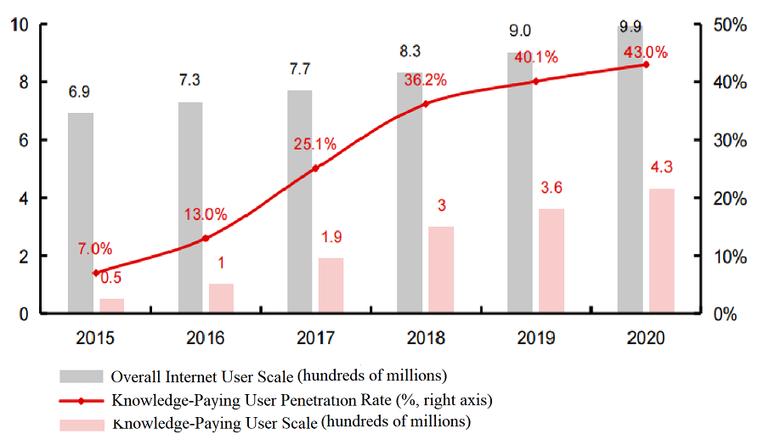
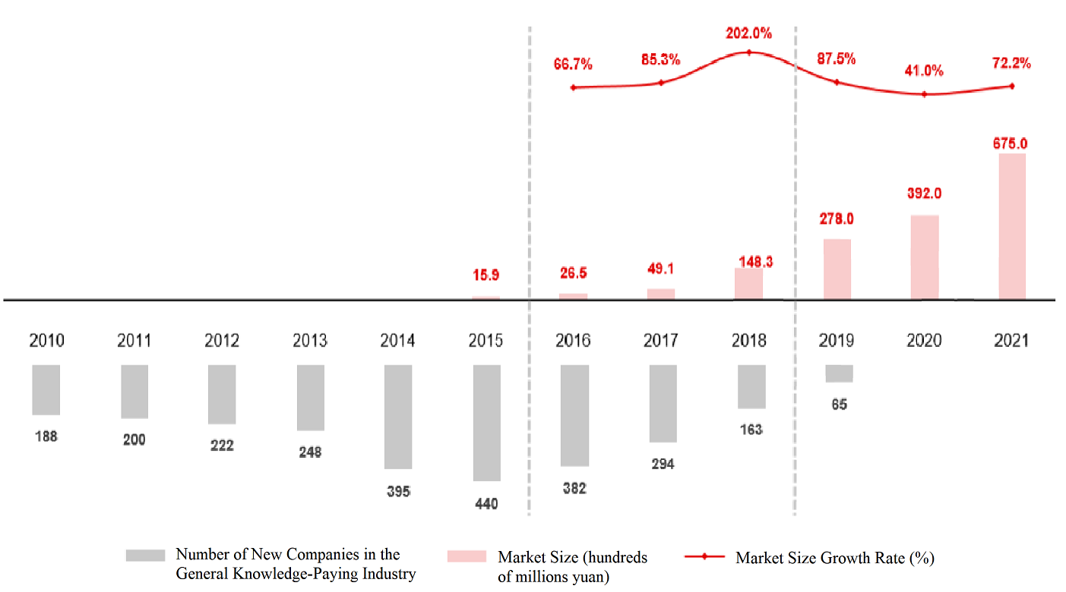
PART I: Company Profile
Market Potential: Growing need of Knowledge Consumption
The Chinese knowledge payment market is growing rapidly, with knowledge consumption in an accelerated penetration phase. The demand for residents' spiritual and cultural construction is gradually being released, coupled with more intense social competition and the trend of lifelong learning, the demand for knowledge content consumption is expanding.
Demand Side: The number of users in China's pan-knowledge payment market reached 430 million in 2020, with a penetration rate of 43% among the overall internet users, and this rate continues to increase.
Supply Side: The threshold for the pan-knowledge consumption industry has decreased, and the knowledge payment track has seen a continuous expansion of the market scale in recent years, exceeding 67 billion yuan in 2021.

Slide 11
PART II: IPO Review
IPO Review

Slide 12
PART II: IPO Review
Basic Information of the IPO
Zhihu-W (2390.HK) Offering Details
Item | Details
Subscription Date | 2022-04-11 Monday
Name and Code | Zhihu-W (2390.HK)
Sponsors | Credit Suisse, JPMorgan, CICC, China Merchants Securities
Listing Date | April 22, 2022 (Friday)
Offering Price | HKD 51.80
Fundraising Amount | The company will not receive any proceeds from the global offering. All net proceeds from the global offering will go to the selling shareholders.
Shares per Lot | 100 shares
Entry Fee | HKD 5,232.21
Offering Period | April 11, 2022 - April 14, 2022
Total Offering Shares | 26 million shares (subject to adjustment and at the option of the Over-Allotment)
International Placement | 23.4 million shares (subject to adjustment and at the option of the Over-Allotment), approximately 90%
Public Offering | 2.6 million shares (subject to adjustment and at the option of the Over-Allotment), approximately 10%

Slide 13
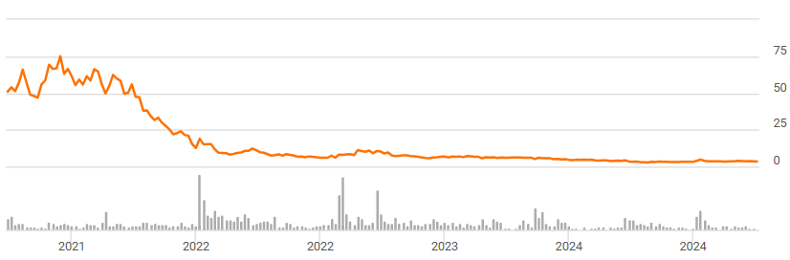
PART II: IPO Review
Key features of Zhihu’s IPO:
Zhihu's listing on the Hong Kong Stock Exchange (HKEX) this time is in the form of a dual primary listing, with the issue price set at HKD 32.06 per share (which is about 40% lower than the annoted price)(the opening price on the day was HKD 24.95, equivalent to RMB 20.67). A total of 26 million Class A ordinary shares from early investors were offered, and the selling shareholders will receive nearly HKD 800 million in net proceeds from the global offering.
At the same time, Zhihu did not issue new shares, which means that this return to Hong Kong does not have the purpose of raising funds. Judging from this move, the company has entered the Hong Kong capital market without diluting existing equity, and has also mitigated the delisting risks commonly faced by Chinese companies listed in the U.S.
IPO in HK
2022.4.22
Huge downward pressure
IPO in NYSE
2021.3.21

Slide 14
PART II: IPO Review
The aim of the dual IPO in HK:
Mitigate Risks: the company is seeking to establish a dual primary listing, which provides equal listing status in both Hong Kong and the United States. This is a strategic move to mitigate the risks associated with potential delisting from U.S. exchanges due to regulatory pressures, such as those imposed by the U.S. Securities and Exchange Commission (SEC) under the Holding Foreign Companies Accountable Act. By having a dual primary listing, Zhihu ensures that a delisting in one market does not affect its status in the other, thus providing stability and security for its shareholders.
Enhance Market Value: Zhihu's aim of IPO in HK includes the desire for investors in Hong Kong to better understand the company and assign it a higher market value. The company believes that mainland and Hong Kong investors are more familiar with its products and strategies compared to U.S. investors, which could potentially lead to a more accurate valuation.
The timing of the Zhihu’s IPO in HK:
The timing of Zhihu's IPO in Hong Kong was strategic, as it provided a sense of stability and security amidst increasing regulatory scrutiny and delisting risks from the U.S. market. The decision to list at this time was also influenced by the company's internal readiness and the opportunity to present itself to investors who are more attuned to its business model and growth prospects, thus capitalizing on the familiar environment and the support of local investors.

Slide 15
PART III: Valuation
Fundamental Valuation & Relative Valuation

Slide 16
DCF: Calculation of WACC
Explanations of data resources
Industry Beta: weekly rate of return of the Internet and related services firms in CSI, at the period of 2021/10/21 to 2022/04/21
Risk free rate: the rate of 10-years government bond
Expected market rate of return: annualized rate of return of Hang Seng Technology index, past five years
Cost of debt: combination of short-term debt and long-term debt
Calculation was done in iFind
Beta Cal
WACC Cal
Index | Hang Seng Index(HIS)
Sector | Internet and related services
Unit of Time | Week
Time Range (six months) | 2021/10/21-2022/04/21
Excluding Financial Leverage (D/E) | By market value
Weighted method | Total Market Value Weighted Average
Original Beta | 0.5066
Weighted Adjusted Beta | 0.6694
Weighted Unlevered Adjusted Beta | 0.6495
Beta | 0.6495
D/E ratio | 0.2347
Tax rate | 15%
Risk free rate | 2.84%
Expected market rate | 7.19%
Risk premium | 4.35%
Cost of Equity | 5.66%
Cost of Debt(after tax) | 4.25%
WACC | 5.33%

Slide 17
DCF: Prediction of Revenue & Profit
Overall Analysis of Revenue and Expenses
Revenue and Increase
Revenue Breakdown
(Revenue in millions of RMB)
Expense
Main Expense Analysis
During the period from 2020 to 2021, the average sales expense ratio was 45%. This was primarily due to an increase in promotion and advertising costs related to attracting new users and enhancing brand recognition.
In the other hand, the average administrative expense ratio was 41.8%, mainly due to an increase in equity incentive expenses and the costs incurred from the company's dual listing on the Hong Kong Stock Exchange.
Future Main Expense Ratio Forecast
It is expected that the administrative expense ratio and the sales expense ratio will decrease annually from 2022 to 2026 to 10% and 25% respectively, and remain stable thereafter.

Slide 18
DCF: Prediction of Revenue & Profit
Revenue Subcategory Analysis
Advertisement Revenue
Membership Fee Revenue
Market of short videos in China 2017-2021
Service Revenue
Other Revenue
Short Video Users in China 2016-2020

Slide 19



DCF: Prediction of Revenue & Profit
Operating Revenue Analysis and Forecast
The growth rate of operating revenue has been continuously declining, with a significant drop to 55% in the latest period of Q1 in 2022, which is only one-third of that in the same period of Q1 in 2021.
Based on the trend of its rapid and continuous decline, it is predicted that the average growth rate of revenue for the whole year of 2022 will be 40%, and it is forecasted that the growth rate will be halved each year for the next two years, which will be 20% and 10% respectively. After 2025, it is assumed that the annual growth rate of revenue will remain constant at 10%.
Revenue Performance
Analysis
In the first quarter of 2020, advertising revenue accounted for the largest proportion, followed by membership fees, while content service solutions and other businesses revenue accounted for a very small proportion.
During the period from Q1 in 2021 to Q1 in 2022, the growth rate of advertising revenue has declined rapidly, and its contribution of total revenue has decreased quarter by quarter. The growth rate of membership fee revenue has declined slowly, and its contribution of total revenue has remained relatively stable. The growth rate of content service solution revenue has also declined rapidly, and its contribution of total revenue first increased and then decreased.
Revenue Analysis by
Subcategories
The growth rate of user numbers is slow
The number of advertisements is somewhat excessive
Short video platforms have risen rapidly
Zhihu's transformation in the short video field has failed
Analysis of Reasons
for Declining
Revenue Growth

Slide 20
DCF: Prediction of Revenue & Profit
 | 2019 | 2020 | 2021 | 2022E | 2023E | 2024E | 2025E | 2026E | 2027E
Operating Revenue | 670.51 | 1,352.20 | 2,959.32 | 4,143.05 | 4,971.66 | 5,468.83 | 6,015.71 | 6,617.29 | 7,279.01
Yoy% | - | 101.67% | 118.85% | 40.00% | 20.00% | 10.00% | 10.00% | 10.00% | 10.00%
Operating Cost | 358.24 | 594.40 | 1,405.42 | 1,936.52 | 2,323.82 | 2,556.20 | 2,811.82 | 3,093.00 | 3,402.30
Yoy% | - | 65.92% | 136.44% | 37.79% | 20.00% | 10.00% | 10.00% | 10.00% | 10.00%
Gross margin | 46.57% | 56.04% | 52.51% | 53.26% | 53.26% | 53.26% | 53.26% | 53.26% | 53.26%
Sells Expense | 1634.73 | 1864.37 | 2237.25 | 1914.09 | 1503.93 | 1654.32 | 1819.75 | 2001.73 | 1634.73
Proportion of Revenue | 55.24% | 45.00% | 45.00% | 35.00% | 25.00% | 25.00% | 25.00% | 25.00% | 55.24%
Administration expense | 1309.88 | 1864.37 | 1740.08 | 1640.65 | 1203.14 | 661.73 | 727.90 | 800.69 | 1309.88
Proportion of Revenue | 44.26% | 45.00% | 35.00% | 30.00% | 20.00% | 10.00% | 10.00% | 10.00% | 44.26%
Financial expense | -14.64 | 5.70 | 74.48 | 163.65 | 209.39 | 218.40 | 209.28 | 196.81 | -14.64
Earned profit | -1039.02 | -515.47 | -1376.07 | -1527.91 | -1403.96 | -805.76 | 287.43 | 989.83 | 1119.78
Yoy% | - | -50.39% | 166.96% | 11.03% | -8.11% | -42.61% | - | 244.37% | 13.13%
Assumptions
Operating Revenue: In the first three years, due to the listing, the business expanded significantly and the revenue growth rate was fast. After 2022, the company‘s revenue is squeezed due to the development of competitive products, and the subsequent growth rate is assumed to be 10% (phase 1).
Gross Margin: Maintain at around 53%, given the fact that it has been maintained for several years.
Expense: Due to the pressure of market competition and the natural limitations of the graphic community, the company needs to spend more money on marketing products, so the cost has a high proportion.

Slide 21
DCF: Free Cash Flow Model
Assumptions
The development of the company is divided into three phase.
Phase I (7 years): The company is in the stages of germination, where the market is inmature and the competition is fierce. Therefore the company will spend much money on Sales and research on new product, and may even suffer from a negative NI at the beginning.
Phase II (6 years): The company gains more customers and has a reletivly stable market share. The expense are under control and the profit becomes more stable. In this phase, the company has a growth rate of 8%.
Phase III (perpetual): The company is mature and enjoys a sustainable growth rate of 0.9%.
PhaseI | 2022E | 2023E | 2024E | 2025E | 2026E | 2027E | 2028E
FCFF | -2350.28 | -2454.92 | -1386.43 | -380.76 | 317.96 | 442.22 | 448.97
WACC | 5.33% | 5.33% | 5.33% | 5.33% | 5.33% | 5.33% | 5.33%
Discount factor | 0.96 | 0.92 | 0.87 | 0.83 | 0.78 | 0.74 | 0.71
Phase II | 2029E | 2030E | 2031E | 2032E | 2033E | 2034E
FCFF | 484.89 | 523.68 | 565.57 | 610.82 | 659.68 | 712.46
WACC | 5.33% | 5.33% | 5.33% | 5.33% | 5.33% | 5.33%
Discount factor | 0.67 | 0.64 | 0.60 | 0.57 | 0.54 | 0.52
FCFF Valuation | Discounted cash flow | Percentage of value
Phase I | -5139.03 | -96.54%
Phase II | 2078.15 | 39.04%
Phase III | 8384.07 | 157.50%
AEV | 5323.19 | -
Less: minority equity | 7.50 | 0.14%
Equity Value | 5315.70 | 99.86%
Divide by: General Capital | 3.17E+08 | -
Price per share | 16.78 | -

Slide 22
DCF: Sensitive test
 | Sustainable growth rate
WACC | 0.56% | 0.61% | 0.68% | 0.74% | 0.82% | 0.90% | 0.99% | 1.09% | 1.20% | 1.32% | 1.45%
3.31% | 45.82 | 46.98 | 48.31 | 49.84 | 51.63 | 53.72 | 56.19 | 59.14 | 62.70 | 67.07 | 72.52
3.64% | 37.84 | 38.73 | 39.74 | 40.90 | 42.25 | 43.81 | 45.64 | 47.81 | 50.39 | 53.51 | 57.33
4.01% | 30.88 | 31.56 | 32.33 | 33.22 | 34.23 | 35.40 | 36.77 | 38.37 | 40.25 | 42.51 | 45.23
4.41% | 24.80 | 25.32 | 25.91 | 26.58 | 27.35 | 28.23 | 29.25 | 30.43 | 31.82 | 33.46 | 35.42
4.85% | 19.47 | 19.87 | 20.32 | 20.83 | 21.41 | 22.08 | 22.84 | 23.72 | 24.75 | 25.95 | 27.37
5.33% | 14.81 | 15.11 | 15.45 | 15.84 | 16.28 | 16.78 | 17.35 | 18.01 | 18.77 | 19.66 | 20.69
5.87% | 10.72 | 10.95 | 11.21 | 11.51 | 11.84 | 12.22 | 12.64 | 13.14 | 13.70 | 14.35 | 15.11
6.45% | 7.14 | 7.32 | 7.52 | 7.74 | 7.99 | 8.27 | 8.59 | 8.96 | 9.38 | 9.86 | 10.41
7.10% | 4.01 | 4.15 | 4.30 | 4.46 | 4.65 | 4.86 | 5.10 | 5.37 | 5.68 | 6.04 | 6.45
7.81% | 1.28 | 1.38 | 1.50 | 1.62 | 1.76 | 1.92 | 2.10 | 2.30 | 2.53 | 2.79 | 3.09
8.59% | -1.09 | -1.01 | -0.93 | -0.84 | -0.73 | -0.62 | -0.48 | -0.33 | -0.17 | 0.03 | 0.24
The stock price is sensitive to fluctuations in WACC, but around the WACC and g values used in our forecast, the share price is still below the actual offering price, so we think the IPO at this time is a bad idea for its investors.

Slide 23
Relative Valuation ——under PE, EV/EBITDA, PS
 |  | Jan.6, 2025 |  | PE |  |  | EV/EBITDA |  |  | PS
Corporate Name | Stock Code | Closing Price (RMB) | Market Value (RMB) | 2022E | 2023E | 2024E | 2022E | 2023E | 2024E | 2022E | 2023E | 2024E
知乎-W | 02390.HK | 8.76 | 22.71 | -3.07 | -4.74 | -4.25 | -2.16 | -1.73 | 0.58 | 1.54 | 1.36 | 0.64
微博-SW | 09898.HK | 67.92 | 161.90 | 28.96 | 22.65 | 6.47 | 11.76 | 17.54 | 3.91 | 2.39 | 2.09 | 1.23
哔哩哔哩-W | 09626.HK | 125.57 | 518.10 | -7.73 | -8.72 | -12.33 | -21.22 | -40.63 | -133.31 | 2.96 | 2.35 | 1.91
虎牙 | HUYA.US | 21.71 | 49.35 | -22.93 | -12.66 | -31.34 | NA | NA | NA | 0.56 | 0.71 | 1.03
快手-W | 01024.HK | 38.02 | 1633.00 | -8.46 | 32.94 | 17.99 | -3.48 | -37.05 | 12.58 | 2.89 | 2.29 | 1.59
爱奇艺 | IQ.US | 1.86 | 135.90 | -10.20 | 16.59 | 9.44 | -8.78 | 2.56 | 1.42 | 0.70 | 1.24 | 0.75
Reddit | RDDT.US | 1269.57 | 2243.00 | NA | NA | -56.76 | NA | NA | NA | NA | NA | 25.57
Average |  |  |  | -14.11 | 3.64 | -11.33 | -11.99 | -13.64 | -21.89 | 2.66 | 1.98 | 4.63
We chose Internet content platform companies for comparison, finding that PE and enterprise multiples often fail due to unprofitability of the enterprises. From the PS point of view, ZHIHU is also not a good investment choice

Slide 24
PART IV: Additional Discussion
Additional Discussion

Slide 25
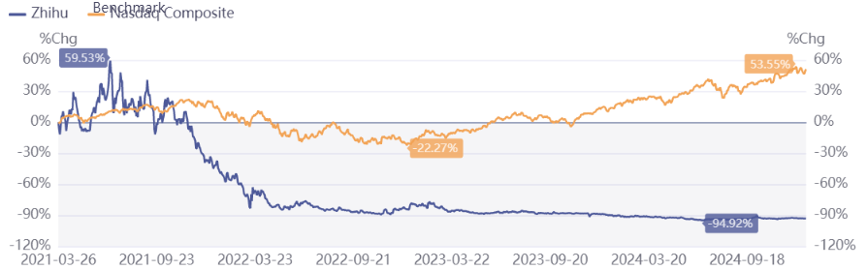
Market comparison in US and Hong Kong
Stage market visualization analysis
Period Market Performance
Nasdaq Index

Slide 26
Price in the US and the Hong Kong stock market
Price in HK
16.78
Price in US

Slide 27
Extension Problems
What were the gains and losses of all possible parties related to the event?
Existing Shareholders
Gains: They might experience significant gains if the stock price appreciates post-listing , especially those who held the stock in US stock market.
Losses: There might be some losses if the stock price fails to appreciate, or worse, drops below the IPO price post-listing in the long run.
New Investors
Losses: If the stock price declines below the IPO price (as seen with the opening price of 24.95 HKD), new investors will face immediate losses.
Management and the Company
Gains: The management likely benefits from the IPO proceeds, along with potential stock-based compensation if their compensation packages include stock options.
Losses: Management might suffer reputational damage if the stock price performs poorly post-IPO, which could also affect management’s ability to raise future capital.
Underwriters
Gains: The underwriters earn fees from facilitating the IPO, irrespective of the stock’s post-IPO performance.
Losses: If the IPO performance leads to a loss of investor confidence, the underwriters might face challenges in future deals.

Slide 28
Extension Problems
Did the management represent shareholders’ interest?
Management’ duty
From the perspective of management, the goal is typically to maximize the value for shareholders, particularly the existing shareholders. If the listing price (32.06 HKD) was set too high compared with our valuation(16.78RMB/20.25 HKD), it could be seen as a misstep in representing shareholder interests because it may have indicated an overvaluation at the time of the IPO.
Do you think this is a good or bad deal from the existing/new investors’ perspective?
Existing Investors
Good Deal: If the stock appreciates in the long term, existing investors (especially early investors) will benefit from the IPO price and subsequent appreciation. These investors likely sold at the right time, locking in profits from an IPO priced at 32.06 HKD.
New Investors
Bad Deal: New investors who bought at the IPO price of 32.06 HKD face immediate losses as the evaluation is 20.25 HKD, which would be a significant drop. Unless the stock price recovers quickly, this would be considered a bad deal for them.

Slide 29
Extension Problems
Do you think the transaction price is fair?
Data
The IPO price of 32.06 HKD, set by the management and underwriters, is higher than the valuation of 20.25 HKD, which suggests that the market may have viewed the IPO as overpriced. The fairness of the transaction price is subjective and depends on multiple factors.
Assessment
Given the market reaction, it seems that the transaction price was somewhat aggressive and did not match the market's immediate perception of the company’s value.
Can you think of a trading strategy to profit from this deal?
Short-term Trading
If the stock price drops after the IPO, a trader could short the stock. However, the risk is that the stock could recover quickly if investors buy in during the dip, making it crucial to monitor for signs of recovery.
Options Strategy
For more sophisticated investors, put options could be considered to profit from further declines in stock price if the sentiment remains negative.

Slide 30
Conclusion
From the firm’s angle:
We think going IPO at this time is a bad idea for company Zhihu, because our valuation suggests market valuation is high.
From investors’/ analysts’ angle:
We hold a negative view on investing in Zhihu IPO, because the offer price is too high compared to the fundamental value.
Key Point

